Slide 1


National Conference on Agriculture for
Kharif Campaign 2022
19th April 2022
KARANTAKA STATE

Slide 2

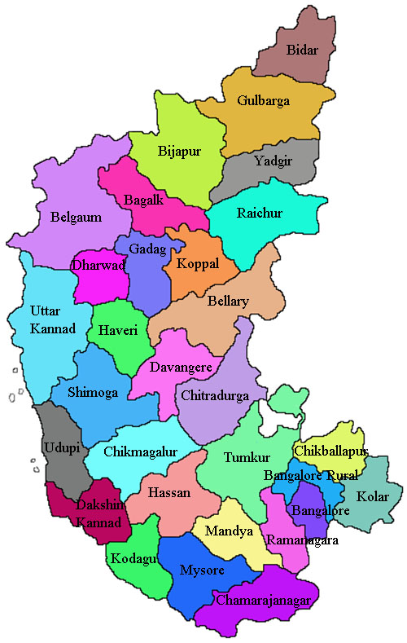
KARNATAKA
Total area in the state is 1.91 lakh sq kms, of which 118.05 lakh hectare is cultivable. Cropping intensity 122%
16 districts out of 31 are drought prone. It is second most drought prone State of the Country.
The area under irrigation in Karnataka is 30.66% of the total agricultural land. Tank and well irrigation is pre-dominant.
Irrigated area wise, it ranks 12th in the country after Punjab-98.8%, Haryana-90.4%, Puducherry 82.3%, Uttar Pradesh-80.3%, Bihar-69.8% etc.
The consumption of chemical fertilizer is 143 Kg /hectare and usage of chemical pesticides is 1.73Kg/hectare.

Slide 3

CROPWISE AREA, ANNUAL PRODUCTION AND YIELD DETAILS
Unit: Area in lakh ha, Production in Lakh Tonnes, Cotton* (prod.170 kg / bale) ,Yield in kgs/Ha , Sugarcane * (Tonnes/Ha)
Sl. No. | Crops | 2019-20 |  |  | 2020-21 |  |  | 2021-22 (3rd Advance Estimate)
 |  | Area | Production | Yield | Area | Production | Yield | Area | Production | Yield
1 | Rice | 11.86 | 39.48 | 3330 | 14.84 | 47.17 | 3179 | 13.41 | 60.98 | 3095
2 | Jowar | 8.68 | 10.45 | 1204 | 7.49 | 9.04 | 1206 | 8.02 | 9.50 | 1186
3 | Ragi | 6.40 | 11.62 | 1816 | 7.85 | 13.69 | 1745 | 8.14 | 10.79 | 1326
4 | Maize | 14.25 | 47.46 | 3329 | 17.27 | 63.72 | 3689 | 16.42 | 53.38 | 3251
5 | Tur | 15.45 | 11.26 | 729 | 16.31 | 12.38 | 759 | 17.19 | 11.45 | 666
6 | Bengalgram | 8.64 | 6.75 | 782 | 7.13 | 4.46 | 625 | 9.80 | 6.92 | 706
7 | Groundnut | 5.04 | 5.03 | 1000 | 7.20 | 7.20 | 1000 | 6.20 | 5.32 | 859
8 | Sunflower | 1.29 | 1.03 | 802 | 1.21 | 1.08 | 895 | 1.61 | 1.36 | 843
9 | Soyabean | 3.2 | 3.79 | 1183 | 3.11 | 3.77 | 1212 | 3.71 | 4.33 | 1165
10 | Cotton | 8.17 | 23.29 | 51000 | 8.20 | 23.17 | 48000 | 6.777 | 19.53 | 49000
11 | Sugarcane (Harvested) | 4.29 | 360.34 | 8900 | 4.43 | 423.17 | 9600 | 5.88 | 564.48 | 9600

Slide 4

Proposed Target of Season-wise Area under Major Agriculture Crops in Karnataka during 2022-23
Crops | KHARIF | RABI | SUMMER | TOTAL
Rice | 10.62 | 0.17 | 2.72 | 13.50
Jowar | 1.24 | 7.59 | 0.08 | 8.90
Ragi | 7.17 | 0.31 | 0.10 | 7.57
Maize | 14.34 | 1.19 | 0.39 | 15.91
Tur | 16.03 | 0.00 | 0.00 | 16.03
Bengal gram | 0.00 | 10.54 | 0.03 | 10.56
Groundnut | 4.61 | 0.92 | 1.25 | 6.78
Sunflower | 0.97 | 0.61 | 0.07 | 1.64
Cotton | 7.28 | 0.41 | 0.01 | 7.70
Sugarcane | 6.51 | 0.97 | 0.39 | 7.87
Total of All crops | 82.67 | 26.68 | 5.20 | 114.55

Slide 5
UNIQUE ACOMPLISHMENTS AND PROGRAMMES OF KARNATAKA

Slide 6
ACCOMPLISHMENTS & PROGRAMMES
1. All the land records in the State are computerized and village maps, their survey numbers geo-reformed and digitized.
2. The State developed Crop Insurance portal by name “Samrakshane” portal (End to End solution)- During Kharif 2021, an amount of 123.42 crores claims have been settled for 1.84 lakh farmers in terms of add on area coverage of Prevented sowing, Mid season adversity, Localized calamity and Post harvest losses.
3. The State has complete information of 74,91,020 farmer in its FRUITS (Farmer Registration and Unified beneficiary InformaTion System) portal. Of which 61,37,783 farmers are land holders and 13,53,237are landless.
4. The state has its K-KISAN (Karnataka Krishi Information Service Area Network) portal in which all the benefits given to farmers under any scheme are recorded and updated.

Slide 7

ACCOMPLISHMENTS
& PROGRAMMES
5. The State extends all its beneficiary payments by DBT to the financial address.
7. Directorate of Secondary Agriculture:
Govt. of Karnataka is pioneer in starting Separate Directorate for Secondary Agriculture. This would facilitate value addition of primary agricultural produce and to create better market opportunities for these produce, in turn leading to the increase in farmers income.
6. PM-KISAN-Karnataka provides additional assistance of Rs 4000 per farming household, an amount of Rs. 1977.67 crore to 50.35 lakh beneficiaries for the year 2021-22 , eligible under PM-KISAN.

Slide 8
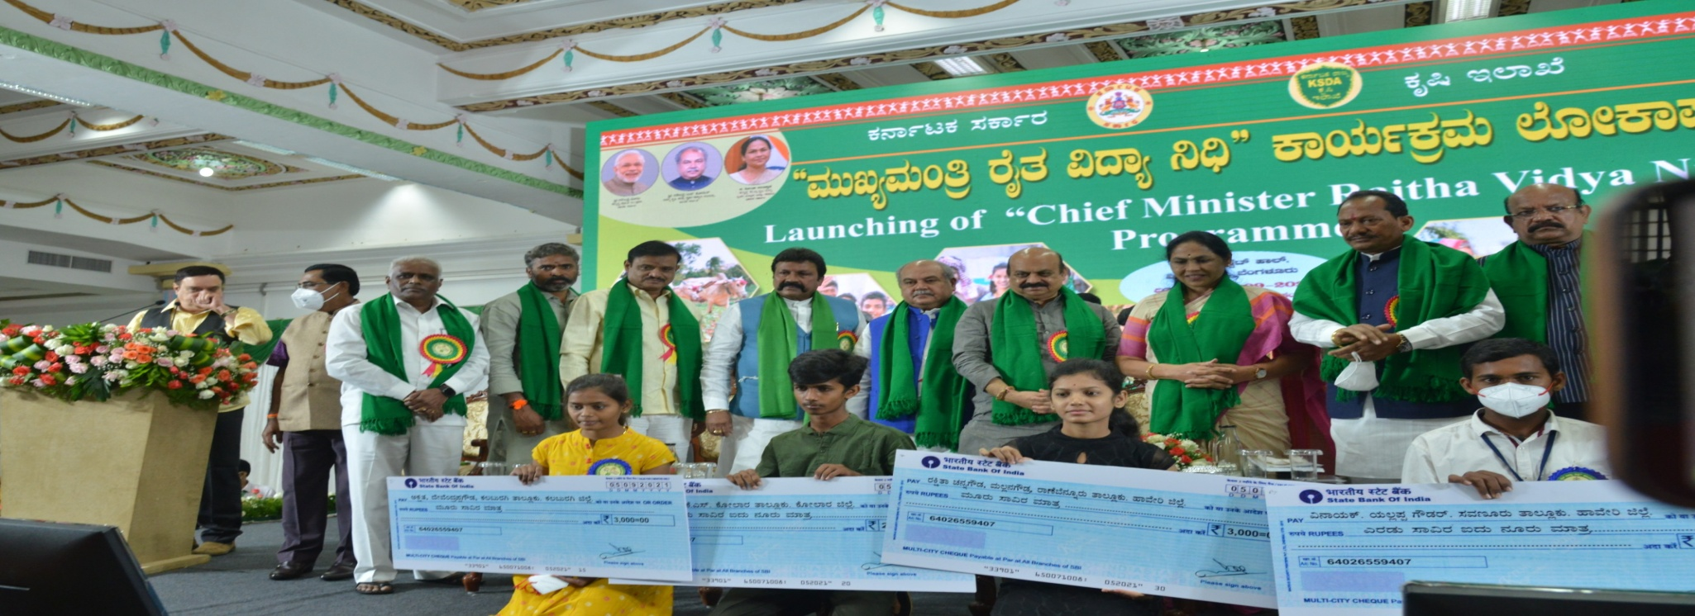
ACCOMPLISHMENTS
& PROGRAMMES
8. “CM-Raitha Vidya Nidhi”: Govt of Karnataka is pioneer in launching the scheme “Raitha Vidya Nidhi”, a sholarship programme for the farmer’s children (Rs. 261.17 crores has been transferred to 7.13 lakh student beneficiaries through DBT during the year 2021-22).

Slide 9
ACCOMPLISHMENTS
& PROGRAMMES
SCHOLARSHIP ON ENTITLEMENT BASIS AND ALSO APPLICATION BASIS:
The State has complete data base of pre matric students and PUC students with unique identity number mapped to AADHAR.
The State also has data base of Family (KUTUMBA Data Base) maintained by e-Governance department and the Student identity can be mapped to his family.
The State also has farmer data base(FRUITS- Farmer Registration and Unified beneficiary InformaTion System) and family members can be mapped for farmer identity

Slide 10
ACCOMPLISHMENTS
& PROGRAMMES
9. Enhancement of Disaster Relief Fund assistance to farming community.
Type of Crop | As per GoI norms (Rs/Ha.) | Additional Assistance (Rs/Ha.) | Revised Assistance (Rs/Ha.)
DRYLAND | 6800.00 | 6800.00 | 13600.00
IRRIGATED | 13500.00 | 11500.00 | 25000.00
PERENNIAL | 18000.00 | 10000.00 | 28000.00
An amount of Rs. 2435.57 crore assistance has been provided to 18.49 lakh farmers during the year 2021-22

Slide 11
ACCOMPLISHMENTS
& PROGRAMMES
10. “A Day with the Farmers”
An initiative by Hon’ble Agriculture Minister, GoK to reach the farmers at their doorsteps in order to understand their field problems and providing timely technical solutions, the Dept. of Agriculture has organized “A Day with the Farmers” programme. Till now, we have organized the programme in 11 districts.
11. Provision of “Jai Kisan” caller tunes for the officers mobile numbers.

Slide 12
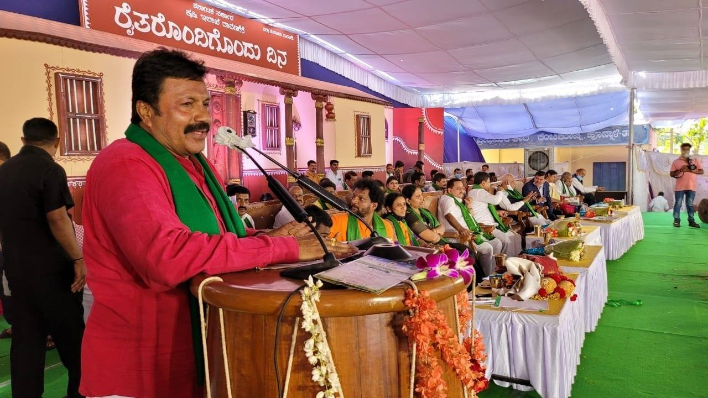
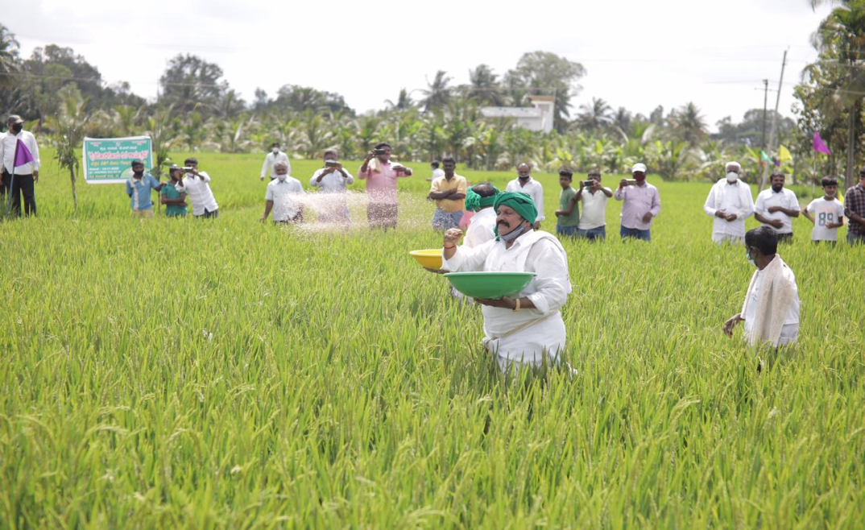
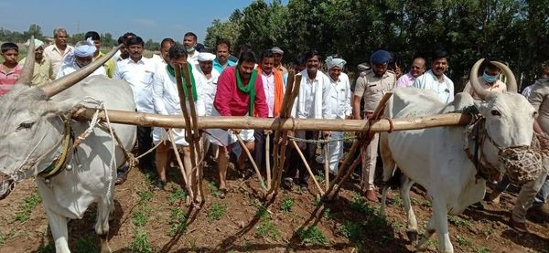
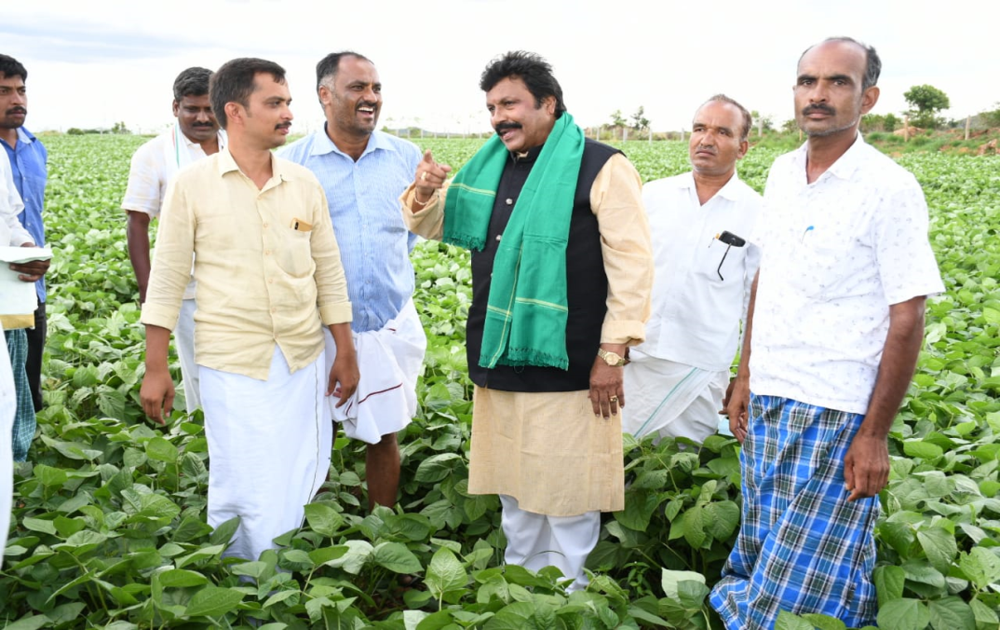
“A Day with the Farmers”

Slide 13
ACCOMPLISHMENTS
& PROGRAMMES
Crop Survey programme is first of its kind in the country and the flagship programme in Government of Karnataka with an intention to involve and empower farmers to record the crops grown on their lands by themselves and to bring in a system for effective capture of survey / sub survey number wise crop information.
Crop survey data is being used in Crop Area Enumeration by Department of Economics and Statistics (DES), Crop Insurance scheme (PMFBY), MSP operation, Input subsidy (NDRF and SDRF), entry of crop details in RTC,, crop loss compensation due to COVID-19 pandemic, Sanction of other beneficiary oriented schemes and for various schemes of the Government.
Bele Darshak App has been developed to allow the farmers to view the details of the crop survey data of his plot and to raise objections and get corrected if any.

Slide 14

CROP SURVEY
Total plots in Karnataka=210 lakhs
Sl. No. | Year | Plots covered in
 |  | KHARIF | RABI | SUMMER | TOTAL
1 | 2017-18 | 152.52 | 0 | 0 | 152.52
2 | 2018-19 | 206.91 | 0 | 0 | 206.91
3 | 2019-20 | 223.75 | 109.35 | 22.86 | 355.96
4 | 2020-21 | 211.45 | 110.75 | 51.62 | 373.82
5 | 2021-22 | 256.96 | 102.62 | 32.53 | 392.11
1. In 2020-21, 80 lakh plot details have been uploaded by farmers or persons outsourced
2. Crop the crop details uploaded in survey were entered in the RTCs is 170 lakh plots in June 2020-21

Slide 15
Mobile Plant Health Clinics
(Krishi Sanjeevini)
“Mobile Plant Health Clinics” have been established for Facilitating early monitoring, identification and guiding of farmers regarding soil conditions, nutritional requirements, pest identification and management as well as to reduce the indiscriminate use of chemical pesticides in order to reduce the residues in crop produce and to promote good agricultural practices.
These clinics will also Suggest timely corrective measures for farmers to increase yields and to reduce the cost of cultivation. 160 Mobile Plant Health Clinics have been established through out the State.

Slide 16
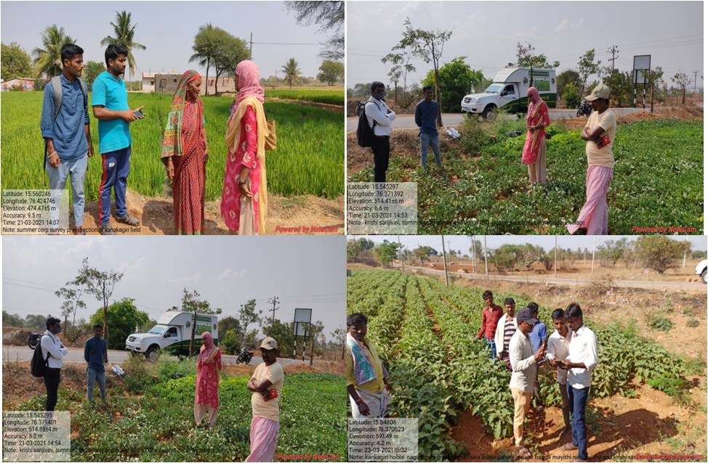
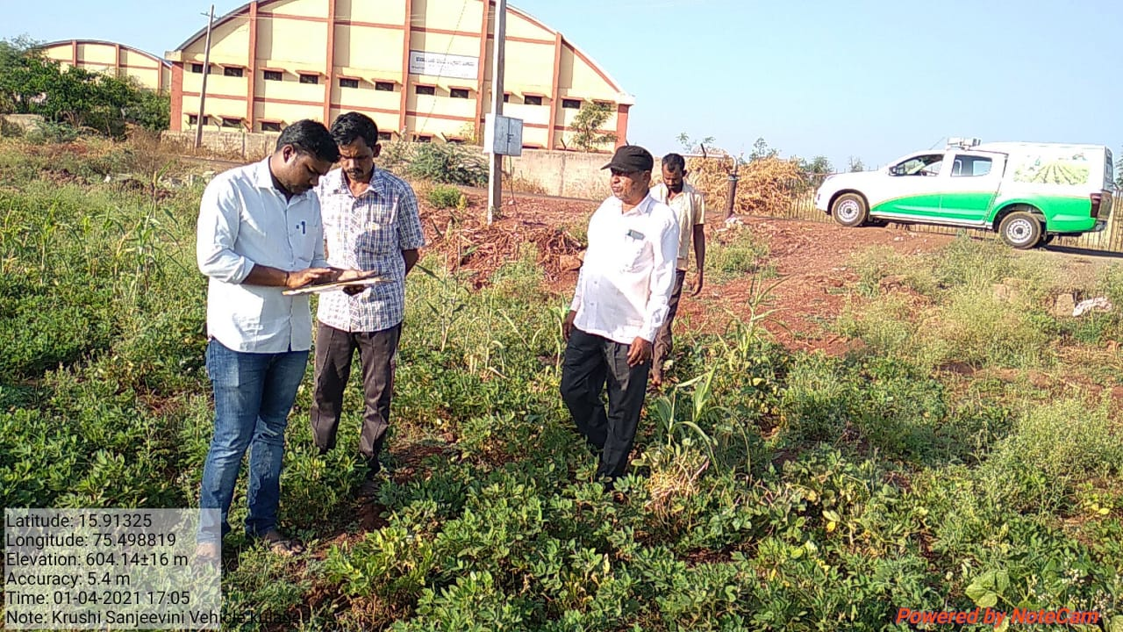
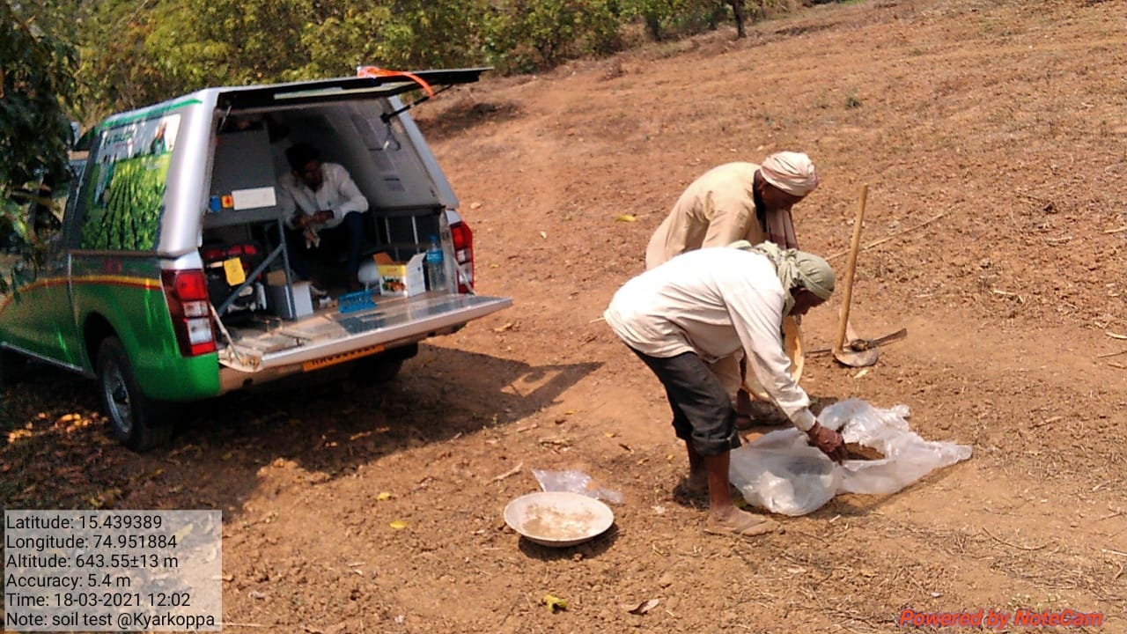
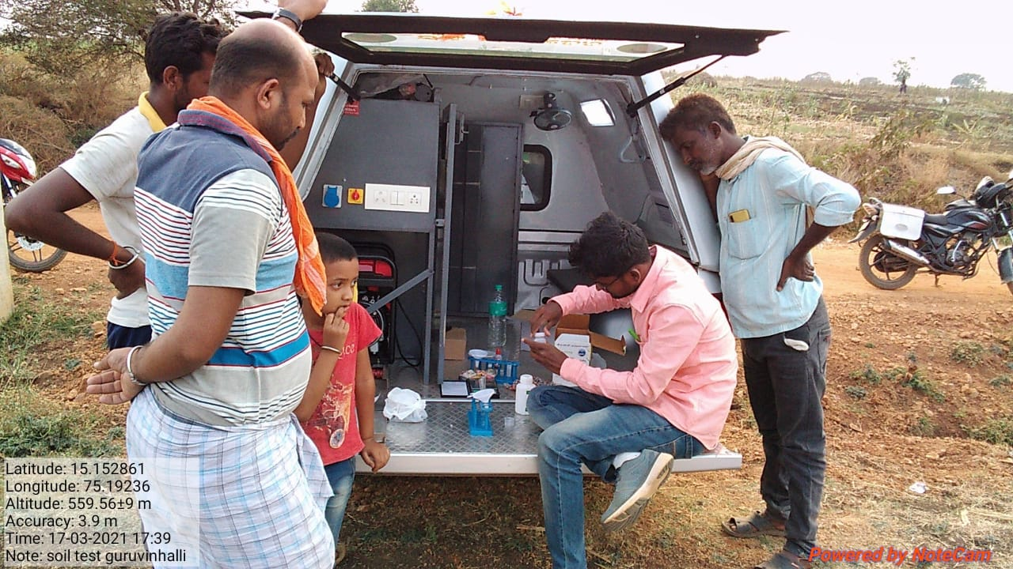
Mobile Plant Health Clinics
(Krishi Sanjeevini)

Slide 17
Budget Announcements for
2022-23
Total Budget For 2022-2023 is 5765.85 cr Out Of Which CSS Budget 1157.42 cr
“Raitha Shakthi”: In order to encourage farm mechanization in the State, Programme has been announced in 2022-23 budget to provide Diesel subsidy of Rs.250/acre(Max. 5 acres) to all the farmers through DBT.
“Chief Minister’s Natural Farming Scheme”: An area of 1000 acres each will be selected under the purview of each of Agricultural /Horticultural University covering a total area of​ 5000 acres. In this area, evaluation/standardization of data with respect to yield stability, productivity, varieties, changes in soil fertility, soil micro-flora and economics in order to bring out a new sustainable natural farming model.

Slide 18
Budget Announcements for
2022-23
“Krishi prashasthi and Krishi Pandita prashasthi for Women farmers”
In order to encourage woman farmers and to attract more women towards farming, separate Krishi Prashasthi and Krishi Pandita Prashasthi will be awarded.

Slide 19
State Specific Action plan for Sunflower
(National Food Security Mission
Sunflower is an important oilseed crop grown in Kharif and Rabi seasons across the country grown in all the 3 seasons in Karnataka and stands first in Area and Production in the country.
During 1990-95 the Area under sunflower in Karnataka was 8 to 15 lakh ha but has reduced to 1.2 to 2.2 lakh ha because of various reasons.
A special action plan is proposed for Increasing the Sunflower Area and Production in Karnataka under National Food Security Mission.
It has been proposed for 3 years viz. 2022-2025 with a total budget outlay of Rs.400.00 crores.
Various immediate and long term interventions are proposed in a Special Action to revive the Area and Production of Sunflower in the state.

Slide 20
State Action plan for Sunflower 2022-2025
Area expansion: Motivational amount for Sunflower growing farmers limited to 2hectares/farmer to based on crop survey data (Rs.3000/ha in 2022-23, Rs.4000/ha 2023-24 & Rs.2000/ha in 2024-25)
Reimbursement of 50% farmers share of PMFBY premium limited to 2 ha/farmer @ Rs.350/ha
Providing 50% subsidy on upto 4 bee boxes per farmer per hectare (Rs.2000/box)
Production of Hybrid seeds
i. Breeder Seed Purchase.
ii.Incentive for Certified seed production
Providing Micronutrients (Boron)
IEC (Training for Sunflower pollination, promotion of Contract farming, administrative cost and evaluation etc.)

Slide 21
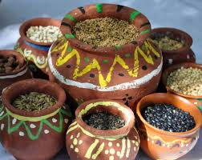
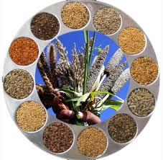
Scenario of Millets in Karnataka
The year 2022-23 has been declared as ‘International Year of Millets’ to boost the production of the nutrient-rich millets and to encourage the agri industries involved in it.
The perspective is to encourage the production of millets-the proven smart food since ages.
Major millets of Karnataka include Jowar, Bajra, Ragi, little millets viz.-little millet(Kutki), kodo millet(Kodo), barnyard millet(Sawa), foxtail millet(Kangni) and proso millet(Cheena).
In order to encourage production of millets in the State “Raitha Siri” programme is being implemented wherein, Rs.10000/Ha production incentive is provided for an area of max. 2.00ha.

Slide 22

THANK YOU

